Slide 1
Network Protocols & Security
[22EC2210R]
CO-1
Reference models: OSI, TCP/IP, Example Networks

Slide 2
AIM OF THE SESSION
Study of OSI and TCP/IP Layers with their comparison.
INSTRUCTIONAL OBJECTIVES
The objective of this course is to understand data communications and gain practical skills on configuration of network devices.
Students will remember and understand the terminology of networking and apply different design issues in different layers of computer networking.
Students will also remember and understand the basics of cryptography and network security and advanced topics.
LEARNING OUTCOMES
By the end of the module on Error Detection in Computer Networks, students will be able to:
Understanding of layered architecture: Students should be able to explain the concept of a layered model and understand the purpose and benefits of dividing network functionality into different layers.
Knowledge of OSI model layers: Students should be familiar with the seven layers of the OSI model (Physical, Data Link, Network, Transport, Session, Presentation, and Application) and their respective functions.
Understanding of encapsulation and de-encapsulation: Students should comprehend the process of encapsulating data at each layer as it moves down the protocol stack and de-encapsulating it as it moves up the stack.

Slide 3
AGENDA
OSI (Open System Interconnection) MODEL
OSI Model Layers
Physical Layer
Data Link Layer
Network Layer
Transport Layer
Session Layer
Presentation Layer
Application Layer
TCP/IP Model (Transmission Control Protocol/Internet Protocol)
Application Layer
Transport Layer
Internet Layer
Host-to-Network Layer
TCP/IP model and relation to Protocols of TCP/IP
Difference between OSI Model and TCP/IP Model

Slide 4
OSI (Open System Interconnection) MODEL
The OSI (Open System Interconnection) MODEL
Established in 1947, the International Standards Organization (ISO) is a multinational body dedicated to worldwide agreement on international standards.
An ISO standard that covers all aspects of network communications is the Open Systems Interconnection model. It was first introduced in the late 1970s.
The OSI model shows how to facilitate communication between different systems without requiring changes to the logic of the underlying hardware and software.
The OSI model is not a protocol; it is a model for understanding and designing a network architecture that is flexible, robust, and interoperable.

Slide 5
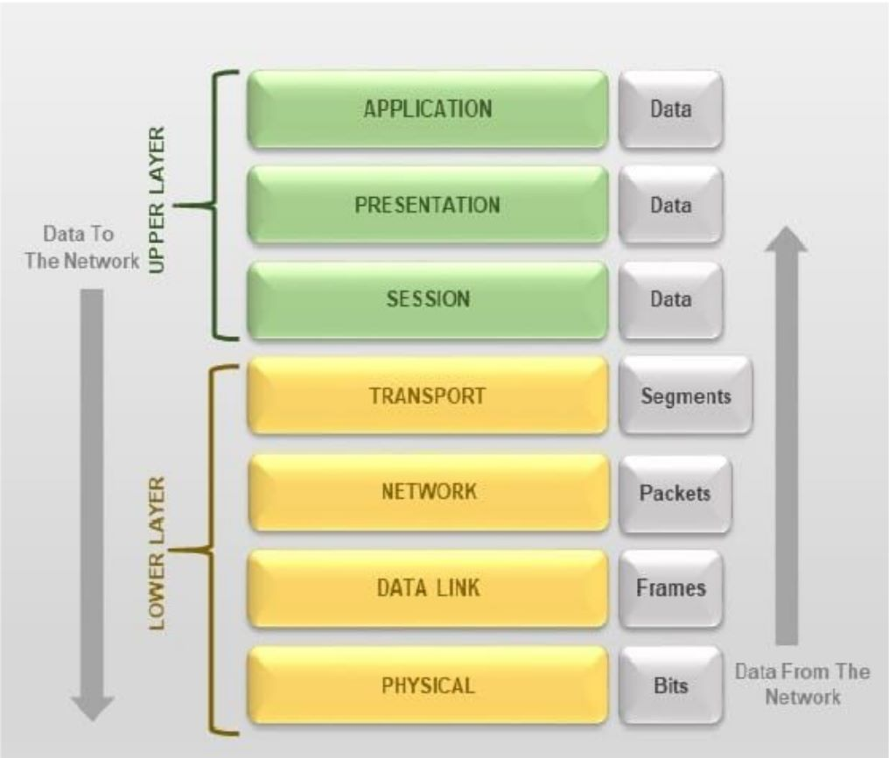
OSI Model Layers

Slide 6
Physical layer
Physical Layer- The physical layer is responsible for movements of individual bits from one hop (node) to the next.
The physical layer is also concerned with the following:
Physical characteristics of interfaces and medium.
Representation of bits.
Data rate.
Synchronization of bits:
Line configuration. point-to-point configuration and multipoint configuration.
Physical topology: Mesh, Bus, Star, Ring and Hybrid Topology.
Transmission mode: Simplex, half-duplex, or full duplex.

Slide 7
Data link layer
Data Link Layer- The data link layer is responsible for moving frames from one hop (node) to the next.
Other responsibilities of the data link layer include the following:
Framing.
Physical addressing.
Flow control.
Error control.
Access control.

Slide 8
Network layer
Network Layer- The network layer is responsible for the delivery of individual packets from the source host to the destination host.
Other responsibilities of the network layer include the following:
Logical addressing.
Routing.

Slide 9
Transport layer
Transport Layer: The transport layer is responsible for delivering a message from one process to another.
Other responsibilities of the transport layer include the following:
Service-point addressing.
Segmentation and reassembly.
Connection control.
Flow control.
Error control.

Slide 10
Session layer
Session Layer- The session layer is responsible for dialog control and synchronization.
Specific responsibilities of the session layer include the following:
Dialog control.
Synchronization.

Slide 11
Presentation layer
Presentation Layer- The presentation layer is responsible for translation, compression, and encryption.
Specific responsibilities of the presentation layer include the following:
Translation.
Encryption.
Compression.

Slide 12
application layer
Application Layer- The application layer is responsible for providing services to the user.
Specific services provided by the application layer include the following:
Network virtual terminal.
File transfer, access, and management.
Mail services.
Directory services.

Slide 13
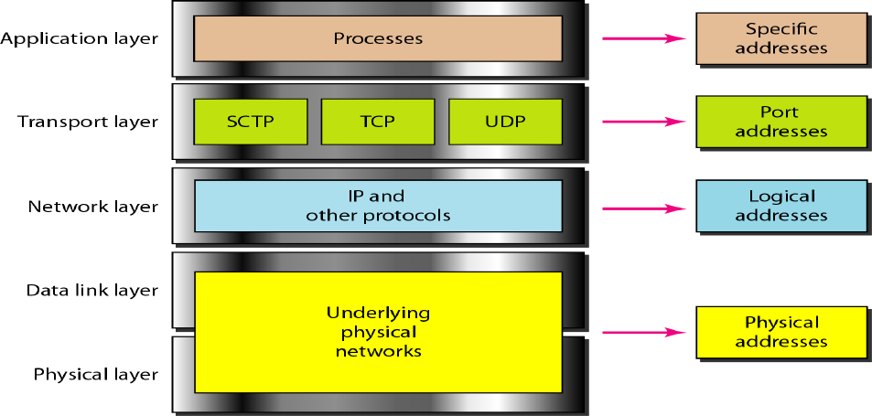
TCP/IP Model (Transmission Control Protocol/Internet Protocol)

Slide 14
Application layer
Application Layer
Application layer protocols define the rules when implementing specific network applications.
Rely on the underlying layers to provide accurate and efficient data delivery.
Typical protocols:
FTP – File Transfer Protocol, For file transfer
Telnet – Remote terminal protocol, For remote login on any other computer on the network
SMTP – Simple Mail Transfer Protocol, For mail transfer
HTTP – Hypertext Transfer Protocol, For Web browsing.
Encompasses same functions as these OSI Model layers application presentation session.

Slide 15
transport layer
Transport Layer
TCP is a connection-oriented protocol.
Does not mean it has a physical connection between sender and receiver.
TCP provides the function to allow a connection virtually exists – also called virtual circuit.
UDP provides the functions:
Dividing a chunk of data into segments
Reassembly segments into the original chunk
Provide further the functions such as reordering, and data resend.
Offering a reliable byte-stream delivery service
Functions the same as the Transport layer in OSI.
Synchronize source and destination computers to set up the session between the respective computers.

Slide 16
internet layer
Internet Layer
The network layer, also called the internet layer, deals with packets and connects independent networks to transport the packets across network boundaries. The network layer protocols are the IP and the Internet Control Message Protocol (ICMP), which is used for error reporting.

Slide 17
Host-to-network layer
Host-to-network layer
The Host-to-network layer is the lowest layer of the TCP/IP reference model. It combines the link layer and the physical layer of the ISO/OSI model. At this layer, data is transferred between adjacent network nodes in a WAN or between nodes on the same LAN.

Slide 18
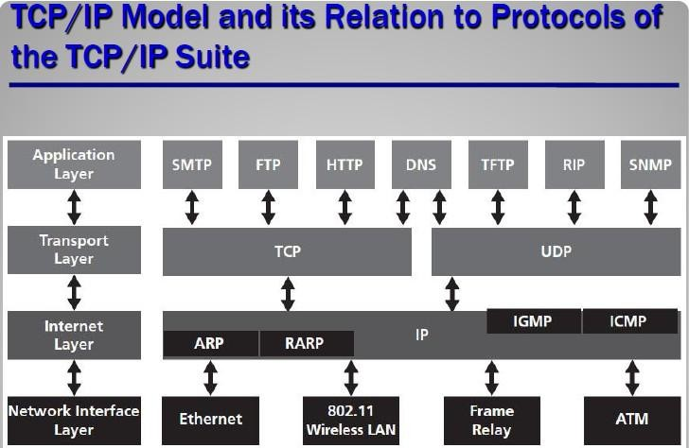
Tcp/ip model AND RELATION TO PROTOCOLS OF TCP/IP SUITE

Slide 19
SELF-ASSESSMENT QUESTIONS
Which layer is responsible for reliable connection?
What are the different protocols that work at each of the layers in OSI model?
List the layers of TCP/IP model.
What is the difference between error control and flow control?
What is the function of a router?
What are the advantages of OSI over TCP/IP model?

Slide 20
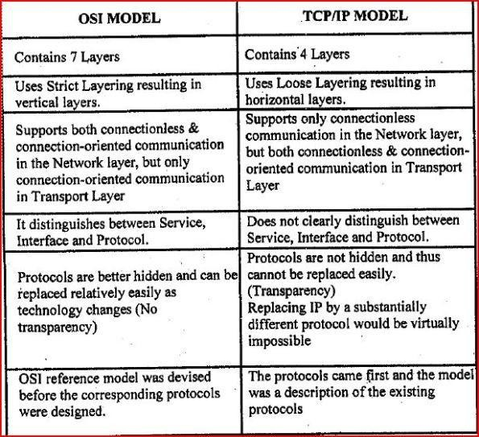
DIFFERENCE BETWEEN OSI MODEL AND TCP/IP MODEL

Slide 21
REFERENCES FOR FURTHER LEARNING OF THE SESSION
Reference Books:
1. Data Communications and Networking, Behrouz A. Forouzan, 4th Edition, McGraw Hill.
2. Computer Networks, Tanenbaum, 6th Edition, Pearson.
Sites and Web links:
CISCO Academy
NPTEL, Computer Networks and Internet Protocols, Prof. Soumya Kanti Ghosh, Prof. Sandip Chakraborty IIT Kharagpur. (https://nptel.ac.in/courses/106105183)

Slide 22

THANK YOU
Team – Networks Protocols & Security

